Slide 1

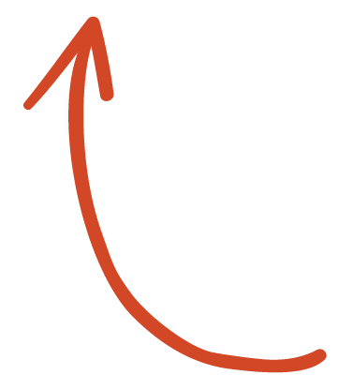
Here's your outline to get started
Key facts about your topic
Salsa is a popular form of social dance originating from Cuban folk dances. The movements of Salsa are a combination of Afro-cuban dance, Son, cha-cha-cha, mambo and other dance forms. The dance, along with salsa music, saw major development in the mid-1970s in New York. Different regions of Latin America and the United States have distinct salsa styles of their own, such as Cuban, Puerto Rican, Cali Colombia, L.A. and New York styles. Salsa dance socials are commonly held in night clubs, bars, ballrooms, restaurants, and outside, especially when part of an outdoor festival.
See more: Open the Notes below for more information.
Notes:
QuickStarter has created an outline to help you get started on your presentation. Some slides include information here in the notes to provide additional topics for you to research.

Slide 2

Related topics to research
Ballroom dance
Cuban salsa
Dance
Rueda de Casino
Tito Puente
Alex Da Silva
Use Smart Lookup to learn more
1
Highlight one of the related topics
Right-click on the topic
Choose "Smart Lookup"
2
3

Slide 3
SALSA
[sahl-suh; Spanish sahl-sah]
William Ona

Slide 4
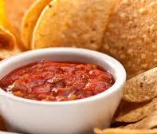
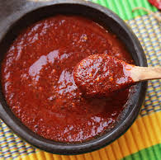
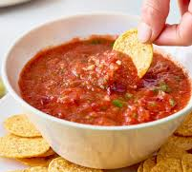
What is Salsa???

Slide 5
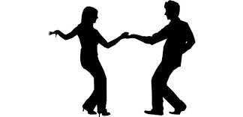
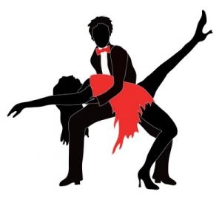
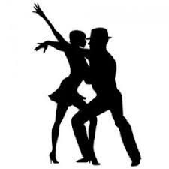
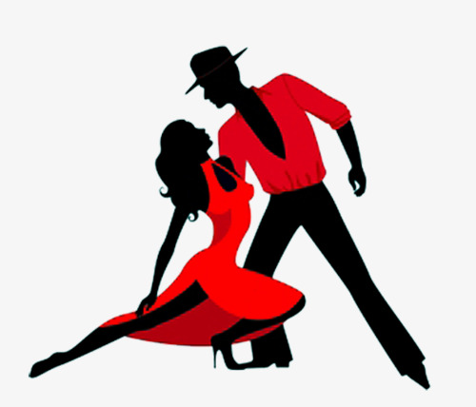
What is Salsa???
A Lively, vigorous type of contemporary Latin American popular music, blending predominantly Cuban rhythms with elements of jazz, rock, and soul music.
Notes:
Social dance is a major category or classification ofdance forms or dance styles, where sociability and socializing are the primary focuses of the dancing.
https://www.dictionary.com/browse/salsa
Gateway drug

Slide 6
Contents
Origin
Background
Rhythm
Styles
Bonus

Slide 7
Origin
Popular in Latin America, the Caribbean and within the US since 1940s
Major developments in 1970s in New York
“Salsa”
Spanish word for sauce
Mixture of different styles and cultures
Hot and Spicy like the sauce

Slide 8
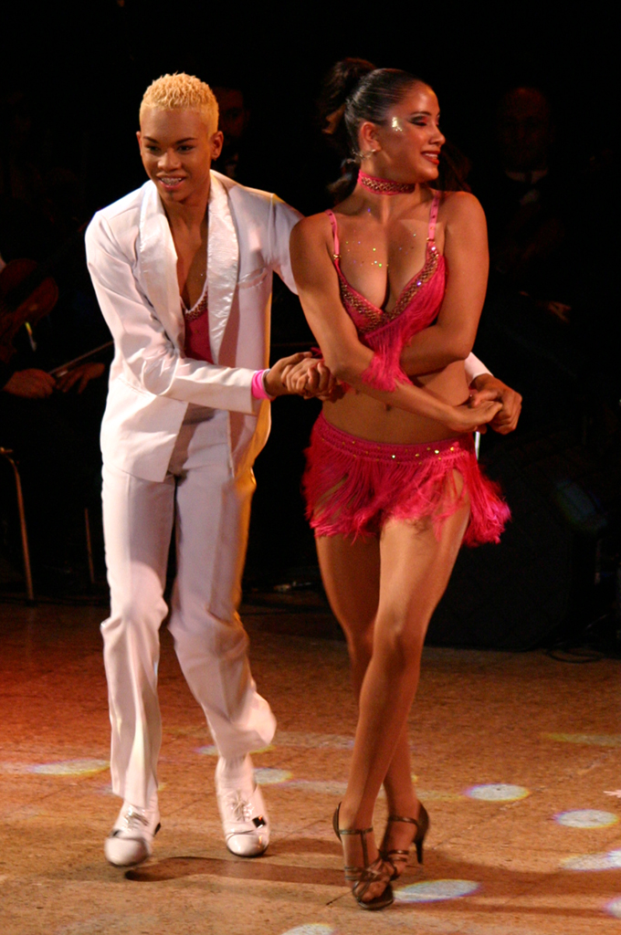

Origin
Music/Dance styles
Son
Cha-cha
Mambo
Bomba
Locations
New York
Cuba
Puerto Rico
Notes:
Jimmy Fontanez/Media Right Productions

Slide 9
Description
Often requires a partner
Lead
Follow
Form of communication
Lead to Follow
Follow to Lead
Can be danced without a partner
Shines

Slide 10
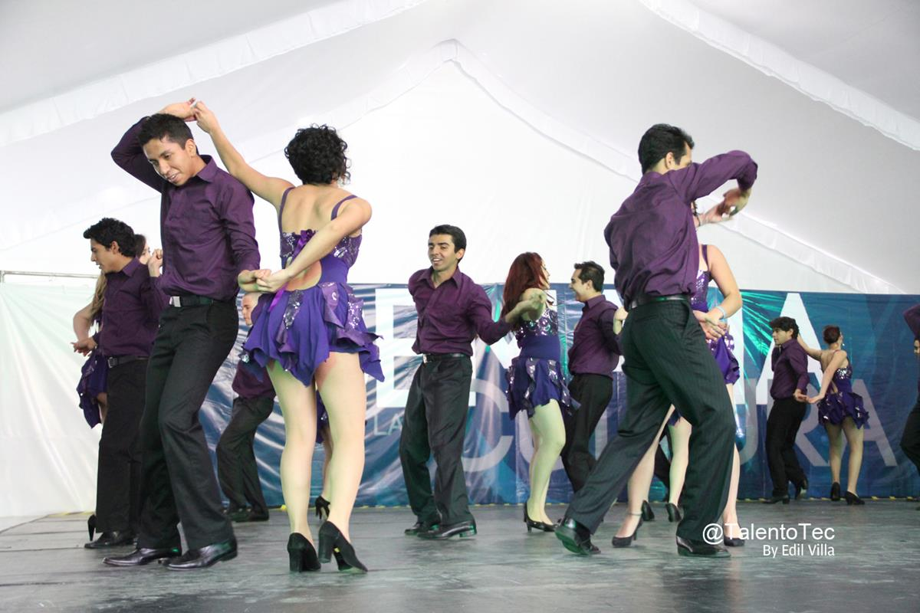
Description
Movement relies on weight shifts
Weight shifting causes hips to move
Arms and shoulders are used as a form of communication
Closed and open position
Improvised or Choreographed

Slide 11
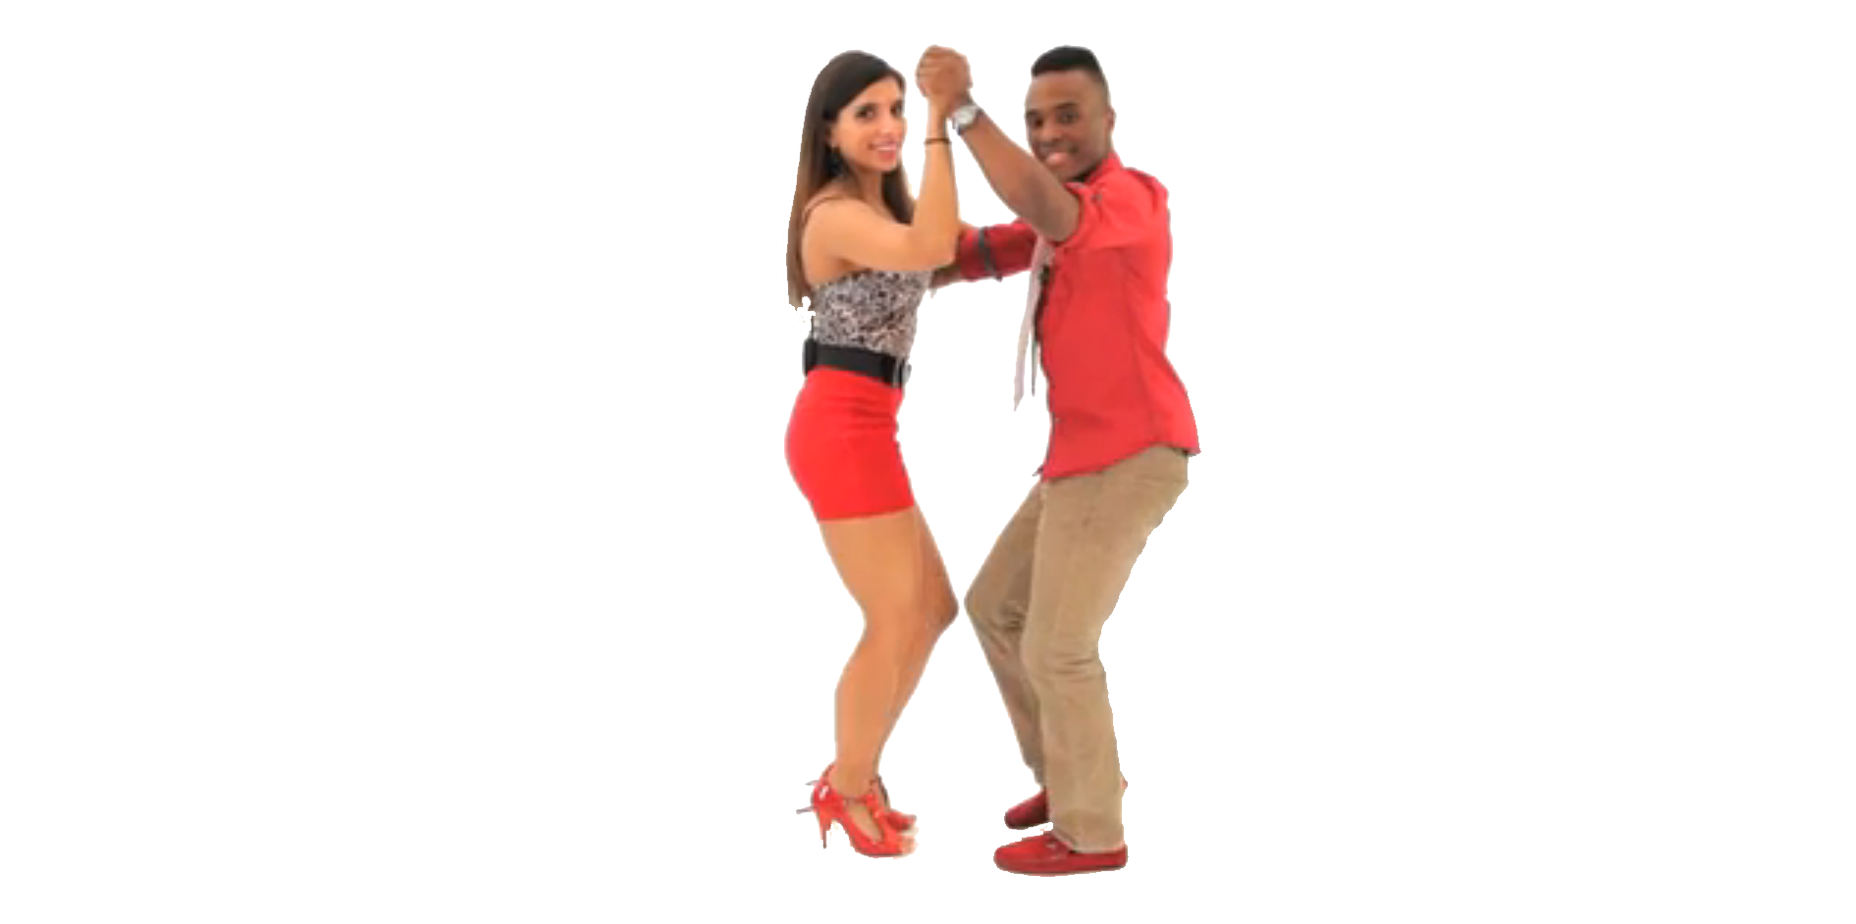
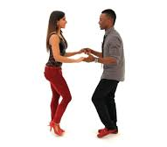
Closed vs. Open

Slide 12
Rhythm
8 beats
4/4 time signiature
Music:150bpm to 250bpm
Dancing: 160-220bpm
Often many overlayed rhythmic patterns playing at the same time

Slide 13
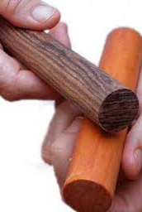
Rhythm
Salsa rhythms are based around the clave rhythm
Key instruments:
Clave, congas, timbales, piano, tres guitar, bongos
Bass, maracas, cowbell

Slide 14
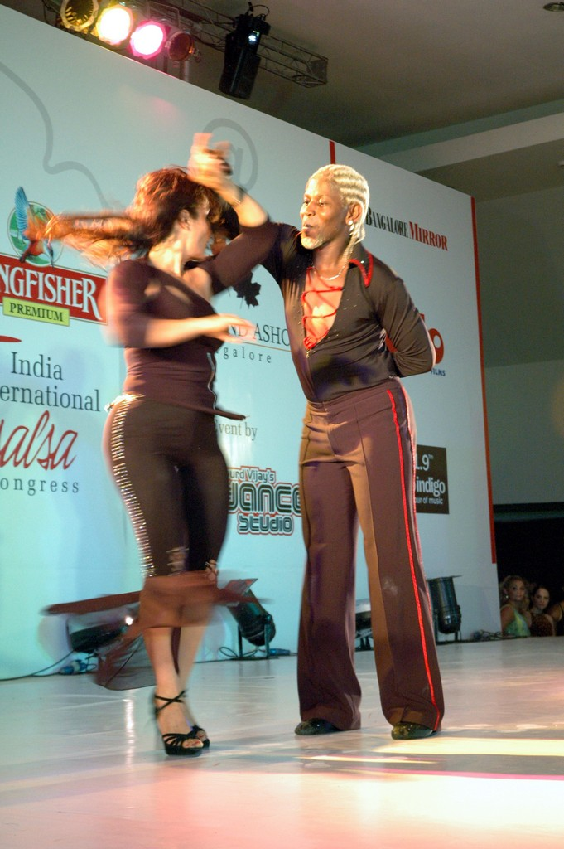
Styles
Identified by: timing, basic steps, foot patterns, bod movement, turns, attitude , etc.
Constantly evolving
LA Style
New York Style
Cuban Style/ Casino
Notes:
Consider talking about:
Afro-Latino style
Colombian / Cali style
Cuban style / Casino
Los Angeles style
New York style

Slide 15
Styles
LA Style
Made popular in Los Angeles
“Salsa on 1”
Salsa in a line
Lead steps forward on 1
Influenced by swing, argentine tango, mambo, and latin ballroom dancing
Can incorporate stunts and aerial lifts

Slide 16
Styles
New York Style
Made popular in New York
“Salsa on 2”
Partners facing each other most of the time
Evolved from Mambo
Emphasis on dancing in harmony with percussive instruments such as congas, timbales and clave

Slide 17
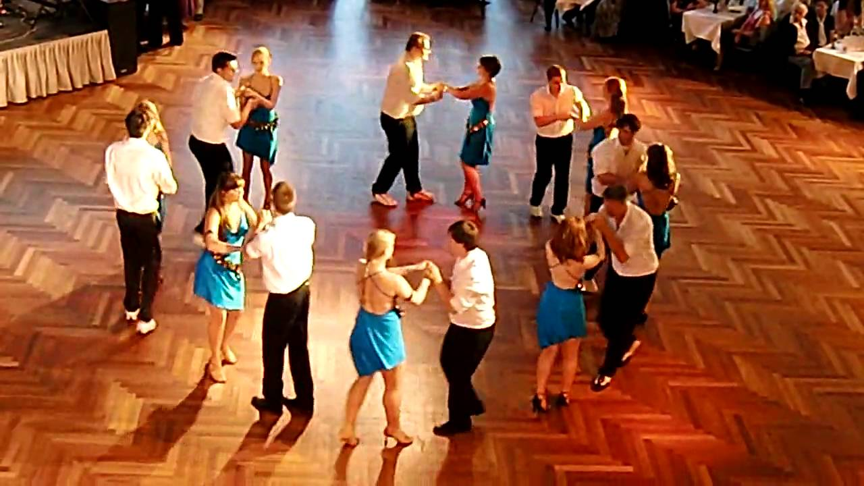
Styles
Salsa Rueda
Rueda de Casino
Social and cultural
Pairs of dancers form a circle
Dance moves called out by one person
Often involves swapping of partners

Slide 18
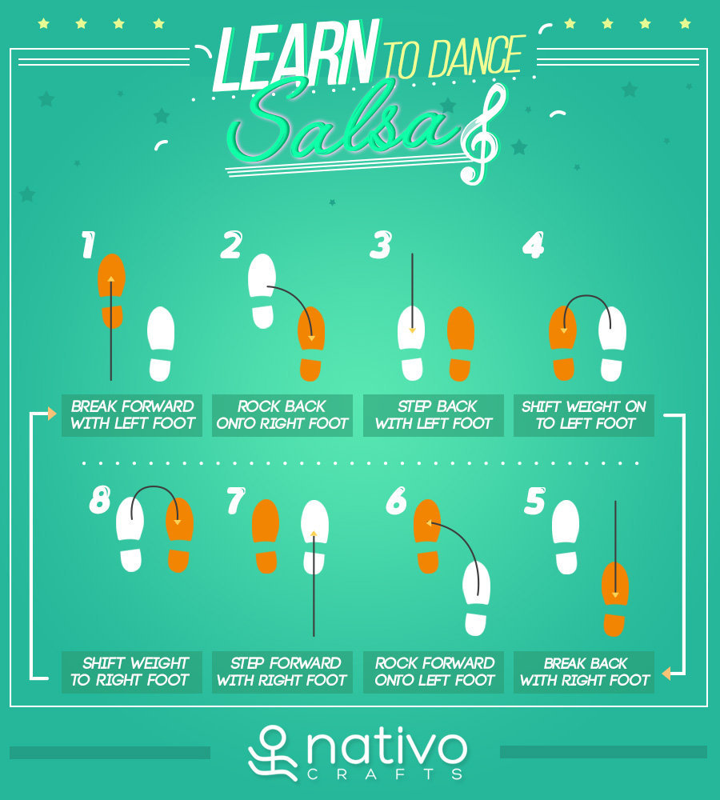
Salsa Basic (On 1)
Notes:
https://nativocrafts.com/wp-content/uploads/2015/07/learn-salsa.jpg

Slide 19
Works cited
https://en.wikipedia.org/wiki/Salsa_(dance)
https://www.dictionary.com/browse/salsa
https://www.youtube.com/watch?v=q5FOwr-jDwQ
https://www.dancingfever.co.uk/benefits-of-salsa-dancing/

